Slide 1
SAP BTP Build Apps Training
Day 5
Anubhav Oberoy
www.AnubhavTrainings.com
Follow excellence with sheer passion

Slide 2


DISCLAIMER
The training content and delivery of this presentation is confidential, and cannot be recorded, or copied and distributed to any third party, without the written consent of Anubhav Trainings

Slide 3
Agenda – Day 5
01
Destinations
02
Binding and Page parameters
03
Flow functions

Slide 4
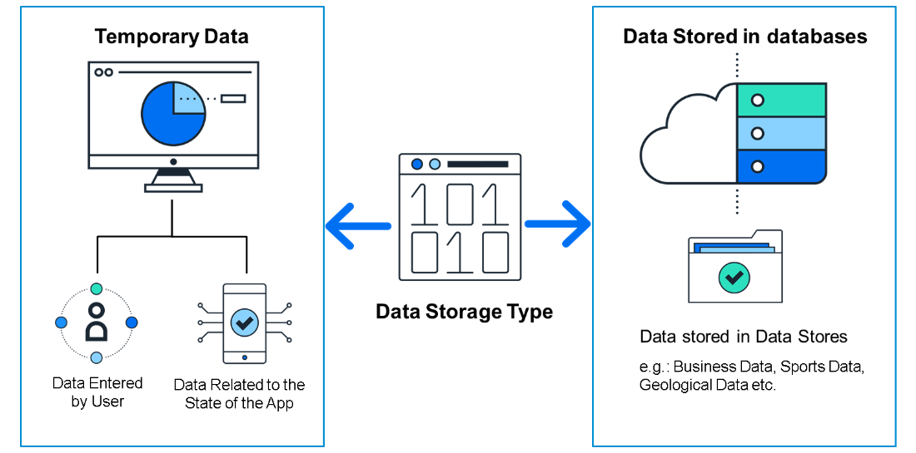
Data Resources in BTP
Applications live and die on their data, and without some form of data, an app wouldn’t be able to do much.
Some data is merely temporary and is stored while the app is running, such as:
Data entered by the user.
Data related to the state of the app; for example, while a user is playing a game, the app would need to store their score, name, and the current state of the board
Some data is stored in data stores or databases for use with other users, for example:
Business data, such as invoices and sales orders.
Sports data, such as teams and players and their statistics.
Geological data, such as earthquakes, their magnitude, and locations.

Slide 5
Types of Data Sources
There are different types of back-end systems from which you can retrieve data
SAP Build Apps lets you connect to the following:
OData Integration - This type of data resource lets you connect to OData services. OData services are services you reach with a URL and are designed for supplying business data. OData services conform to a rigid set of rules for defining the format of the URLs and of the returned data.
REST API Direct Integration - This type of data resource lets you connect to REST services. REST services do not need to conform to the same rigid rules for URLs and responses, as OData services do. This can make REST services require a little more work to understand, and to configure within SAP Build Apps.
On-Device Storage - This data resource actually creates a data store on the device the user is using, as opposed to REST and OData data resources, which connect to existing data stores. Such data is only stored on the current user’s device, so it is used for data needed only by the current user and that does not have to be shared.
Marketplace Data Resources - Marketplace data resources can be of any type. They are data resources that are defined and stored in the Marketplace and can be quickly installed from there. You may want to use the few data resources prebuilt for you, or you may want to create a data resource and be able to quickly reuse it in multiple projects.

Slide 6
Additional Data Resource types
There are some additional and important data resource types – especially for use in connecting to SAP back-ends – that depend on users being authenticated via SAP BTP
Visual Cloud Functions Integration - Visual Cloud Functions lets you easily create your own data store, not just connect to an existing one, and let multiple apps access it and let you share the data among many users.
OData Integration with BTP Destination - OData with a BTP destination is the same as without except that the URL and authentication is defined by an SAP BTP destination.
REST Integration with BTP Destinations - REST with a BTP destination is the same as without except that the URL and authentication is defined by an SAP BTP destination.

Slide 7
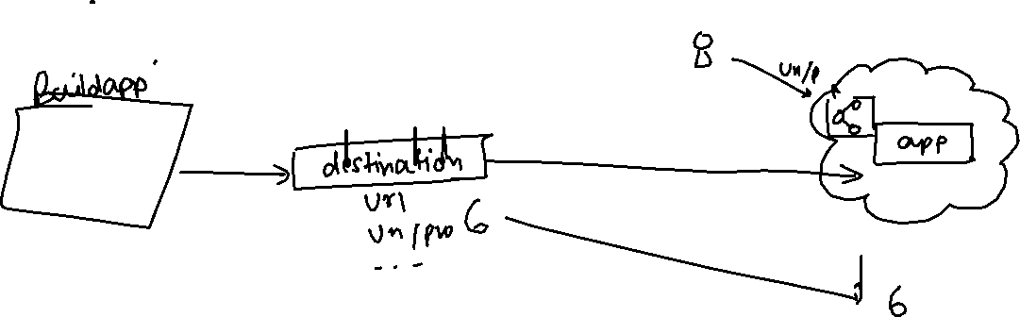
What is Destination in BTP
SAP BTP Destination is a configuration object within SAP Business Technology Platform (BTP) that allows applications to connect to external systems or services in a secure and managed way.
These destinations store connection settings like URLs, authentication, and proxy settings, enabling seamless communication between your BTP applications (like those running on SAP CAP, UI5, or Fiori) and other systems (such as on-premise SAP systems, third-party APIs, or cloud services).
cap

Slide 8
Create destination to simple OData Service
Type=HTTP
HTML5.DynamicDestination=true
Authentication=NoAuthentication
Name=AnubhavOData
WebIDEEnabled=true
sap.processautomation.enabled=true
sap.build.usage=odata_gen
Appgyver.Enabled=true
sap.applicationdevelopment.actions.enabled=true
ProxyType=Internet
URL=https://orderscapapp.cfapps.eu10.hana.ondemand.com/service/OrderManagement
Images:
https://ui5.sap.com/test-resources/sap/m/demokit/cart/webapp/localService/mockdata/images/HT-1020.jpg

Slide 9
Data Resources in BTP
Applications live and die on their data, and without some form of data, an app wouldn’t be able to do much.
Some data is merely temporary and is stored while the app is running, such as:
Data entered by the user.
Data related to the state of the app; for example, while a user is playing a game, the app would need to store their score, name, and the current state of the board
Some data is stored in data stores or databases for use with other users, for example:
Business data, such as invoices and sales orders.
Sports data, such as teams and players and their statistics.
Geological data, such as earthquakes, their magnitude, and locations.

Slide 10
Types of Data Sources
There are different types of back-end systems from which you can retrieve data
SAP Build Apps lets you connect to the following:
OData Integration - This type of data resource lets you connect to OData services. OData services are services you reach with a URL and are designed for supplying business data. OData services conform to a rigid set of rules for defining the format of the URLs and of the returned data.
REST API Direct Integration - This type of data resource lets you connect to REST services. REST services do not need to conform to the same rigid rules for URLs and responses, as OData services do. This can make REST services require a little more work to understand, and to configure within SAP Build Apps.
On-Device Storage - This data resource actually creates a data store on the device the user is using, as opposed to REST and OData data resources, which connect to existing data stores. Such data is only stored on the current user’s device, so it is used for data needed only by the current user and that does not have to be shared.
Marketplace Data Resources - Marketplace data resources can be of any type. They are data resources that are defined and stored in the Marketplace and can be quickly installed from there. You may want to use the few data resources prebuilt for you, or you may want to create a data resource and be able to quickly reuse it in multiple projects.

Slide 11
Additional Data Resource types
There are some additional and important data resource types – especially for use in connecting to SAP back-ends – that depend on users being authenticated via SAP BTP
Visual Cloud Functions Integration - Visual Cloud Functions lets you easily create your own data store, not just connect to an existing one, and let multiple apps access it and let you share the data among many users.
OData Integration with BTP Destination - OData with a BTP destination is the same as without except that the URL and authentication is defined by an SAP BTP destination.
REST Integration with BTP Destinations - REST with a BTP destination is the same as without except that the URL and authentication is defined by an SAP BTP destination.

Slide 12
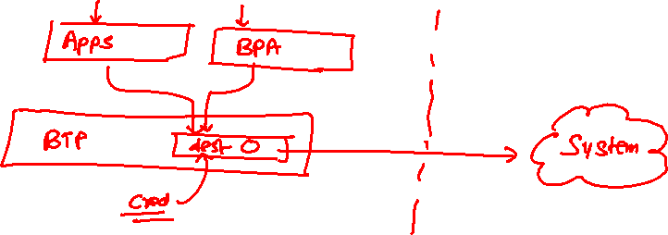
What is Destination in BTP
SAP BTP Destination is a configuration object within SAP Business Technology Platform (BTP) that allows applications to connect to external systems or services in a secure and managed way.
These destinations store connection settings like URLs, authentication, and proxy settings, enabling seamless communication between your BTP applications (like those running on SAP CAP, UI5, or Fiori) and other systems (such as on-premise SAP systems, third-party APIs, or cloud services).

Slide 13
Create destination to simple OData Service
Type=HTTP
HTML5.DynamicDestination=true
Authentication=NoAuthentication
Name=AnubhavOData
WebIDEEnabled=true
sap.processautomation.enabled=true
sap.build.usage=odata_gen
ProxyType=Internet
URL=https://orderscapapp.cfapps.eu10.hana.ondemand.com/service/OrderManagement
Appgyver.Enabled=true
sap.applicationdevelopment.actions.enabled=true
Images:
https://ui5.sap.com/test-resources/sap/m/demokit/cart/webapp/localService/mockdata/images/HT-1020.jpg

Slide 14

Scenario – Shopping cart App
🧑‍💼 Persona: Alex Taylor – Procurement Manager
Age: 34
Location: Chicago, USA
Industry: Manufacturing
Role: Manages procurement for factory supplies and spare parts
Goals:
Quickly find and order necessary items
Ensure availability before reordering
Manage procurement on-the-go between sites
🎯 Objective
Design a user-friendly mobile app that allows Alex to:
Browse available products
View detailed product information
Add items to a shopping cart
Place and track orders

Slide 15
Binding Concept
You created a data variable for the Products data, and the logic for retrieving the data was created automatically. Now you need to tell the app what to display.
To do this, you create bindings for your UI components, indicating what data you want to display in your component, whether from:
Static values
Calculated values
Values from variables
… or other sources
How Binding works
When you configure a UI component (or later a logic component called a “flow function”), generally you do this with binding.
For most properties, there is a binding icon that indicates what type of binding is used. For example, you can use static text for a text field, or you can show text from a backend service and use a binding to a data variable.

Slide 16
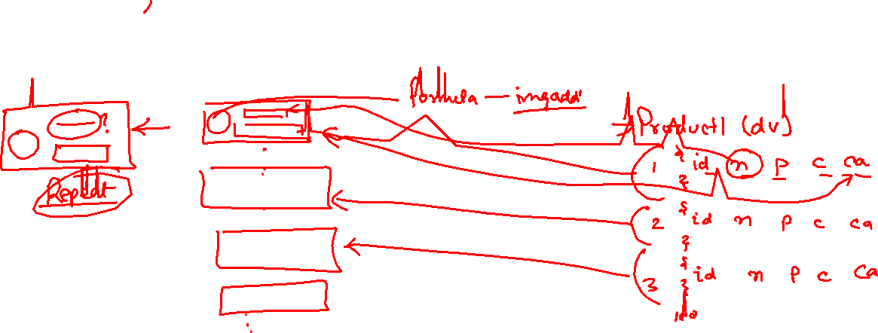
What is repeat?
The Repeat with property lets you create multiple copies of a component by supplying a list – this will repeat the component based on the number of elements in your list, for example, the number of products in our list. The list can be hardcoded, or can be located in a variable (like in our case), or based on a formula.
Once you set the Repeat with property, you then get the Data item in repeat binding option for the other properties in the component. You can now access values within each list item. So the data in the first item will be displayed in the first copy of the component, the data in the second item in the second copy of the component, and so on.

Slide 17
Types of data variables
There are 3 kinds of data variable, which determines its underlying data type (list vs. object) and the inputs that are required:
Collection of data records: A list of objects. This is what was automatically selected when you created a data variable for the products in the product list page. No inputs are required.
Single data record: Just a single object. You will generally have to provide a key so SAP Build Apps knows which object to return.
New data record: Just a single object. This object is empty but contains the schema for this data resource so it can be easily bound to UI components for the user to enter their data, and to flow functions so the data resource can be updated.

Slide 18
Page parameters
Page parameters can only be of the text type. Page parameters are read-only variables that can be set with the Open page flow function for the new page, e.g. ID of a product for a product details page.
Page 1
Page 2
page
parameter

Slide 19
Understanding flow functions
Starting with an event, multiple logic flows can be combined to perform any function and action as needed. These are built in the Logic Canvas and become visible by choosing the lower bar in the UI Canvas and can be expanded by dragging the bar.
There are the three different types of Logic Canvas:
Global Logic Canvas
The Global Logic Canvas can be reached in the page collection.
Page Logic Canvas
At the Page Logic Canvas, you can see integrated page spinners that are set in the function in such a way that it disappears when a page is loaded.
Component Logic Canvas
Different logics can be found in the Component Logic Canvas by default, depending on the selected component. For example, more logics can be shown if a component also has several subcomponents and access.
As with the components, a core trunk covers the most common use cases and the possibility of additional flow functions from the Marketplace. These are later available in the Logic section and can be constantly expanded. Also these can then be found under the Installed tab. The default flow functions in the Core tab and additional functions from the Marketplace thus provide the tools to optimize the app logic and associated functions.

Slide 20

What We Did
Let’s Summarize

Slide 21

www.anubhavtrainings.com
Thank You
End of Day 5

Slide 22


We’re committed to empower you to be
#FutureReady
through powerful training solutions.
We build the workforce of the future.
250+
Corporate Clients
30,000+
Learners Trained
25000+
Learners Placed
FREE WEBINARS
Sign up for free webinars with industry experts every fortnight!
Enroll Now!
Contact us today!
https://anubhavtrainings.com

